Slide 1
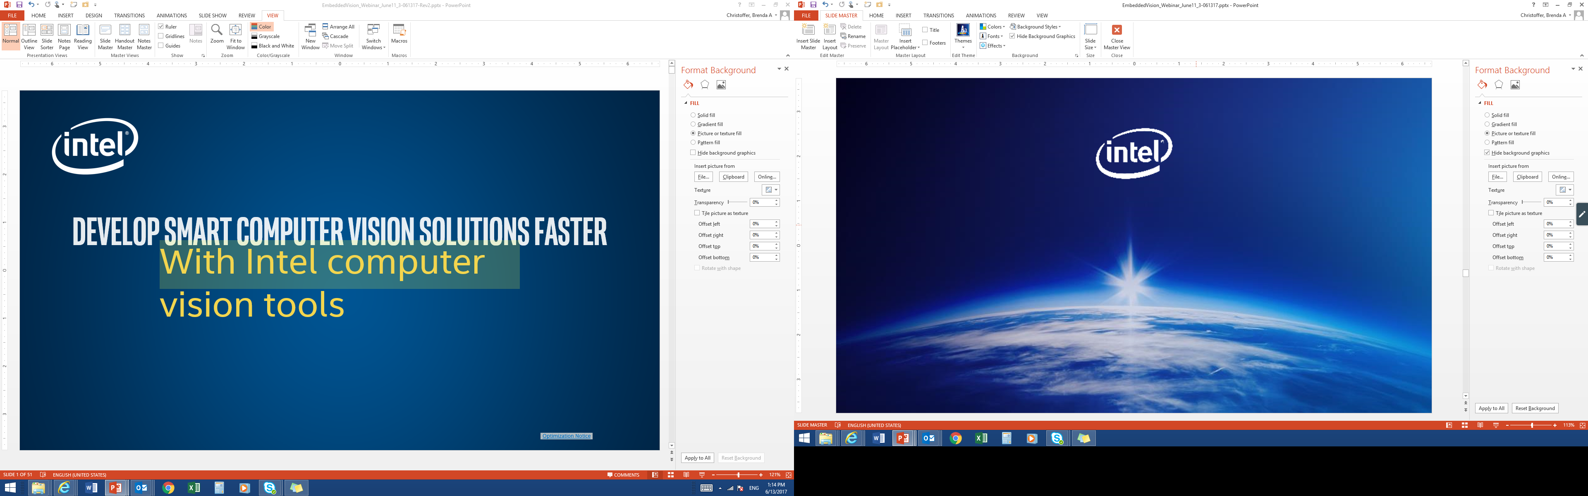

Accelerate Deep Learning Inference using Intel® Technologies
Optimization Tools and Techniques
Intel™ Computer Vision SDK
Intel™ Media SDK
Intel® SDK for OpenCL™ Applications
Intel® System Studio
Hardware:
CPU
Intel® Processor Graphics
Intel® FPGA
Intel® Movidius™ Myriad™ 2
Optimization Notice

Slide 2
Smart video Workshop Overview
Introduction
Basic End to End Object Detection Example:
2a. Intro to Inference Engine
2b. Basics of Model Optimizer
CVSDK 101
Introduction to Intel® technologies for deep learning inference
Hardware acceleration techniques
H/W Acceleration
3. HW Acceleration with CPU, Integrated GPU, Intel® Movidius™ NCS, FPGA
Each Module contains a hands-on lab exercise that will introduce to various Intel technologies to accelerate computer vision application with hardware heterogeneity.
4. Optimization Tools and Techniques
Optimization
5. Advanced Video Analytics
Application

Slide 3
Optimizing inference applications
Model optimizer: tune parameters.
Use/train a model with the right performance/accuracy tradeoffs. Performance differences between models can be bigger than any optimization you can do at the inference app level.
Use an optimized inference implementation. Performance difference between using Inference Engine and a non-optimized framework can be bigger than differences between accelerators.
Use the right data type for your target HW and accuracy needs
Use async
Don’t infer every frame if not needed
Use Intel® VTune™ Analyzer
Optimize the whole pipeline

Slide 4
Model conversion with Model Optimizer
General topology-level opts are automatic
User knobs:
Precision
Batch (SSD!)
--scale and --mean_values
--reverse_input_channels

Slide 5
1. Pick the right model

Slide 6
1. Use/train a model with the right performance + accuracy tradeoffs.
Performance is based on many factors:
Topography complexity / layer implementation + scheduling
# of color channels (i.e. BGR vs. greyscale)
Model resolution

Slide 7
Exercise: range of model performance
Fill out this table:
 | CPU ms/frame | GPU ms/frame
ssd512
ssd300
ssd GooglenetV2
Mobilnet-ssd
Use tutorial1. Models can be found in /home/intel/workshopApr25/model_downloader/object_detection/common
example:
$ cd workshopApr25/workshop-tutorials/build/interop_tutorials/tutorial_1
$ ./tutorial_1 –fr 32 –m /home/intel/workshopApr25/model_downloader/object_detection/common/ssd/512/caffe/FP32/ssd512.xml

Slide 8
2. Use inference engine

Slide 9
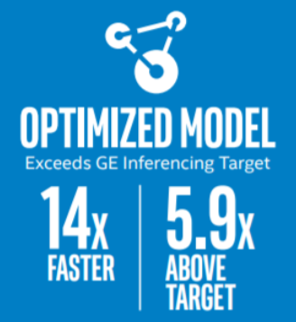
2. Use an optimized inference implementation.
vs. baseline
https://ai.intel.com/wp-content/uploads/sites/53/2018/03/IntelSWDevTools_OptimizeDLforHealthcare.pdf

Slide 10
The performance difference between running inference engine vs. unoptimized can be bigger than the difference between accelerators.

Slide 11
Inference Engine Samples: measure the things right
Beware of the one-time costs (OpenCL kernels compilation)
Measure Infer and other items (pre-processing, decoding) separately
Multiple iterations (“-ni”)!
Batching (“-i”) !
Performance Counters (“-pc”)
Device (“-d”, and “-d_...”)
Latency vs. Throughput (asynchronous case)
Classification(_async)/ObjectDetectionSSD samples

Slide 12
Inference Engine, CPU-specifics, 0
CPU plugin relies on the MKL-DNN for major primitives’ acceleration
Inspect the internal Performance Counters (“-pc”)
MKLDNN_VERBOSE (advanced!), separates IE and raw MKL-DNN
1- dumps execution stats only
2- execution and creation stats
Internally, the MKL-DNN is made parallel with OpenMP*
KMP_BLOCKTIME=1 or 0 is must have when used with accelerators
OMP_NUM_THREADS = #phys_core and further*
KMP_AFFINITY=granularity=fine,verbose,compact,1,0
*Batching (yes!)
Lightweight networks (<1ms) and many-core machine

Slide 13
Inference Engine, CPU-specifics, 1
Example “-pc” output from the sample (notice the helper layers)
conv1 EXECUTED layerType: Convolution realTime: 706 cpu: 706 execType: jit_avx2
conv2_1_x1 EXECUTED layerType: Convolution realTime: 137 cpu: 137 execType: jit_avx2_1x1
fc6 EXECUTED layerType: Convolution realTime: 233 cpu: 233 execType: jit_avx2_1x1
fc6_nChw8c_nchw EXECUTED layerType: Reorder realTime: 20 cpu: 20 execType: reorder
out_fc6 EXECUTED layerType: Output realTime: 3 cpu: 3 execType: unknown
relu5_9_x2 OPTIMIZED_OUT layerType: ReLU realTime: 0 cpu: 0 execType: undef
Custom Layers
Examples in the “extension” dir in the samples folder
Few flavors (SSE/AVX2/AVX512)
Watch for outstanding Reorders, and use blocking format (nchw_8c)
Use openmp as parallel engine

Slide 14
Inference Engine, GPU-specifics
Prefer fp16 over fp32
MO can generate both variants and the fp32 is default
Use batches (SSD!)
OpenCL kernels compilation overhead
Custom Kernels
Before implementing a full-blown code estimate the final performance by stub ("infinitely" fast) kernel that does nothing
Merge chain of custom kernels into a super-kernel
Only heavy layers are worth offloading (plus “glue” layers)
Don’t impl lightweight layers for GPU, keep them on the CPU

Slide 15
Inference Engine, few FPGA tips
First iteration with FPGA is always significantly slower than the rest, make sure you run multiple iterations (“-ni”)
If CPU utilization of concern, minimizes the busy wait time when OMP threads loop in between parallel regions:
set KMP_BLOCKTIME=0
consider playing OMP_NUM_THREADS
FPGA performance heavily depends on the bitstream

Slide 16
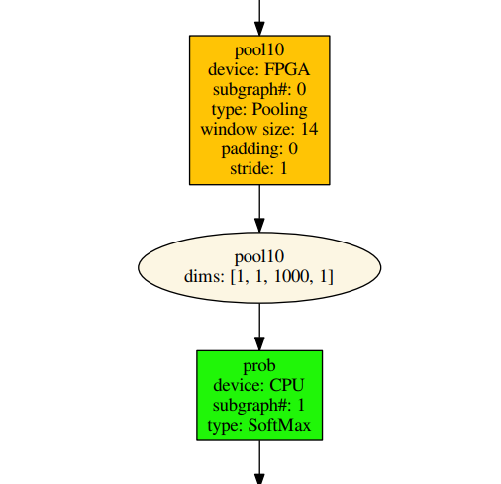
Inference Engine, hetero with FPGA
Just like for the MYRIAD, min 2 infer requests in flight are recommended to hide the data transfer costs
(notice that 5 is HW-implied limit for the FPGA today)
All stages are observable in VTune (next foils)
Perf counters (“-pc”)
subgraph1: 1. input preprocessing (mean data/FPGA):EXECUTED layerType: realTime: 129 cpu: 129
subgraph1: 2. input transfer to DDR:EXECUTED layerType: realTime: 201 cpu: 0
subgraph1: 3. FPGA execute time:EXECUTED layerType: realTime: 3808 cpu: 0
subgraph1: 4. output transfer from DDR:EXECUTED layerType: realTime: 55 cpu: 0
subgraph1: 5. FPGA output postprocessing:EXECUTED layerType: realTime: 7 cpu: 7
subgraph2: EXECUTED layerType: SoftMax realTime: 10 cpu: 10
Total time: 4212 microseconds
Image “Classification Sample, pipelined”
More on hetero: link

Slide 17
3. use the right data type

Slide 18
3. Use the right data type
 | FP32 | FP16
CPU | yes | no
GPU | yes | recommended
MYRIAD | no | yes
FPGA/DLA | no | yes
FPGA/DLA also supports FP11

Slide 19
4. use async

Slide 20
Running Multiple Requests Simultaneously
Every new thread that calls the CPU plugin implicitly spawns full set of OpenMP threads
This also happens for every loaded network
As it gets it’s own dedicated thread automatically
Hence, make sure you do not oversubscribe the machine:
//these two networks go thru same plugin (aka device) and their requests will not overlap.
auto executable_network0 = plugin.LoadNetwork(network0, {PluginConfigParams::KEY_EXCLUSIVE_ASYNC_REQUESTS, PluginConfigParams::YES});
auto executable_network1 = plugin.LoadNetwork(network1, {PluginConfigParams::KEY_EXCLUSIVE_ASYNC_REQUESTS, PluginConfigParams::YES});
Hetero device, uses the EXCLUSIVE_ASYNC_REQUESTS by default
No notion of requests’ “priorities”, left to the user side

Slide 21
Inference Engine Async API
Improves overall frame-rate of the application
Execute a request asynchronously (in the background) and wait until ready, when the result is actually needed
The app can continue doing things on the host, while accelerator is busy.
This demo keeps two parallel infer requests and while the current is processed, the input frame for the next is being captured. This essentially hides the latency of capturing, so that the overall framerate is rather determined by the MAXIMUM(detection time, input capturing time) and not the SUM(detection time, input capturing time).
Intel Confidential

Slide 22
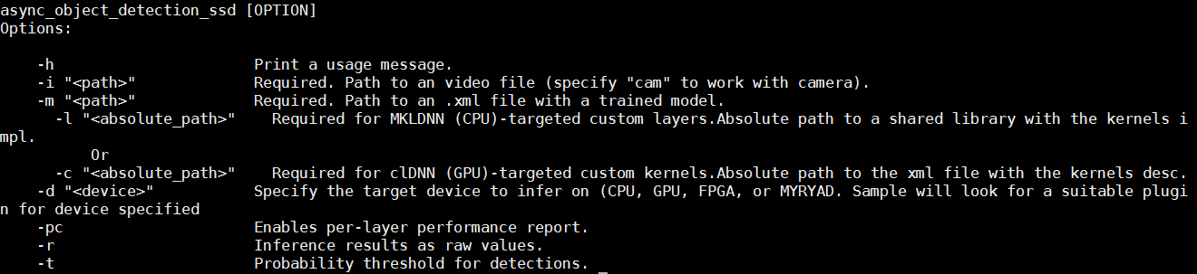
Object Detection sample SSD Async
$ ./object_detection_demo_ssd_async -h
Intel Confidential

Slide 23
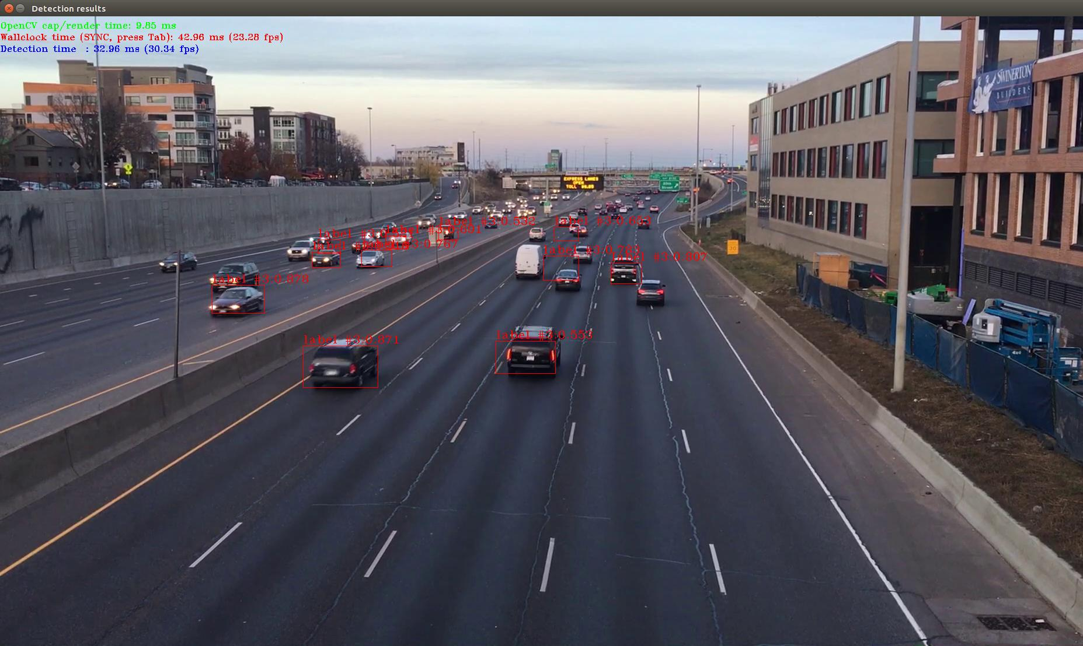
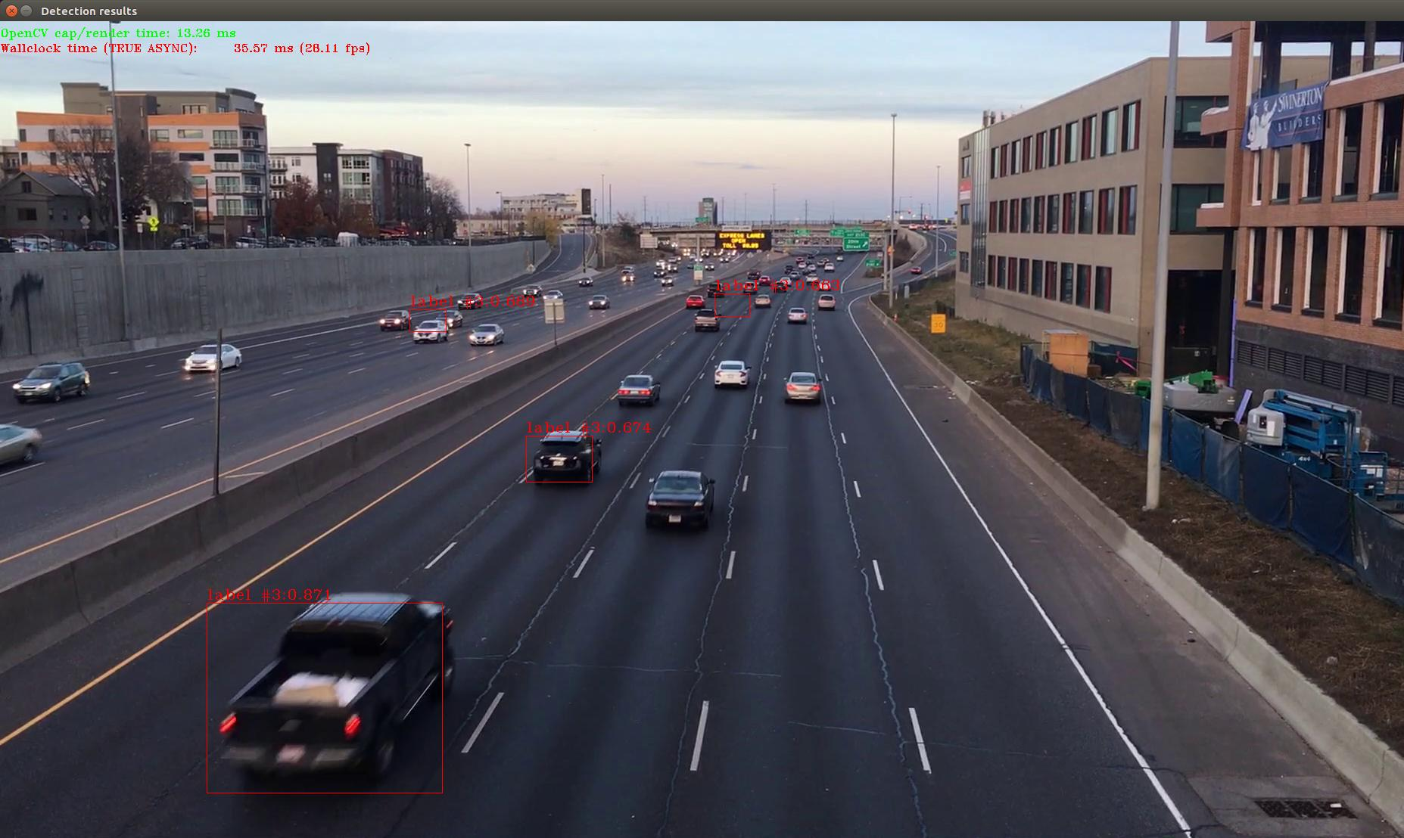
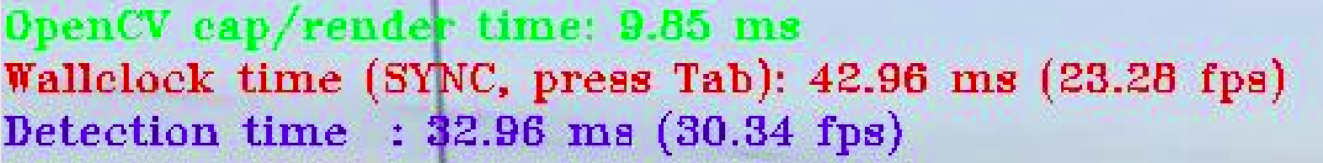
Running object detection sample SSD Async
$ ./object_detection_demo_ssd_async -i /home/intel/workshopApr25/workshop-tutorials/test_content/video/cars_1920x1080.h264 -m /home/intel/workshopApr25/workshop-tutorials/test_content/IR/SSD/SSD_GoogleNet_v2_fp32.xml
Synchronous mode
Press “Tab” to enable asynchronous mode
Intel Confidential

Slide 24
5. don’t infer if not needed

Slide 25
Tracking
Many ways to do it
optical flow
Kalman filters
single/simplistic tracking (what we show here)
Multiple object tracking: like above but find ways to identify each single region so rectangles have a persistent identity over time

Slide 26
A tracking thought experiment
processing in batches already introduces latency
resize, reorder
Infer
read frames

Slide 27
what if we did less inference?
infer
previous position
interpolate
read frames
Infer
parse output
resize, reorder

Slide 28
Determine if there is nothing to see
Inference is expensive to run each frame. It can save time to not run when there is nothing to identify.
check motion vectors
frame sizes
bgsubmog
SAD
These methods can be several orders of magnitude less expensive than inference. Use techniques like this to increase the total # of streams your system can watch.

Slide 29
6. Use Intel® VTune™ Amplifier

Slide 30
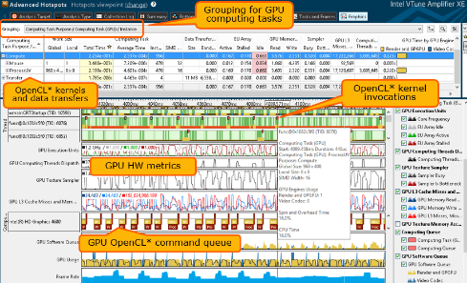
GPU Profiling for Linux* and Windows* Hardware and OpenCL* Metrics
Intel® Integrated Graphics hardware metrics
Details OpenCL™ activity on the GPU
Correlated with CPU processes and threads
Now on Linux* and Windows*
* See this Getting Started article

